Slide 1
UNMASKING
THE
UNSEEN
Security and Privacy Risks Lurking in Your Office Computer

Slide 2
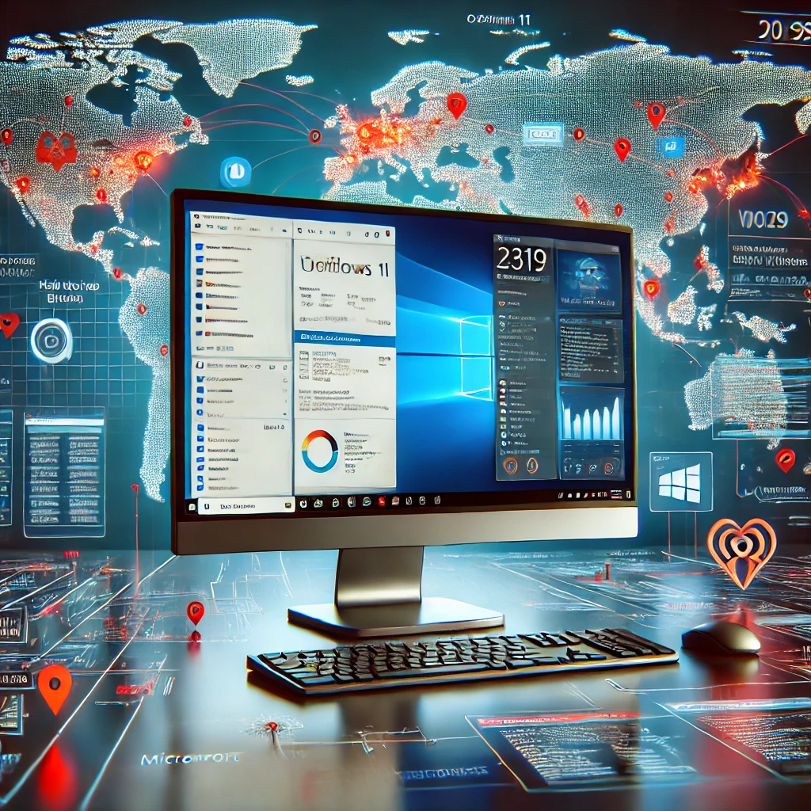
AGENDA
AGENDA
Sub headline
Managed IT is not enough
TeamOne.Support
Unique Security Focused Perspective
What Lies Beneath
Hidden Dangers
Data Privacy Risks
Regulatory Compliance, State and Federal Laws
The Best Of Times..
The worst of Times
Protecting you FROM IT
Protecting Brand Reputation
Never enough time to do it right
Always enough time to do it over again
What you don’t know CAN hurt you

Slide 3
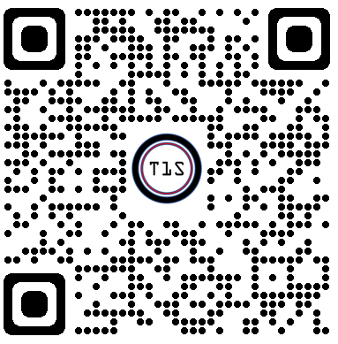
AGENDA
More then just Break/Fix
Sub headline
Michael Scheidell, CCISO
@scheidell
561-948-1305 / michael.scheidell@TeamOne.Support
http://TeamOne.Support
Background in Robotics
Patents in Information Security
Worked with the FBI, US Secret Service
US State Department Secrets
Managed Security 2001-2012
Security Consulting 2012-2024
Mentoring US Veterans 2020
Founded TeamOne.Support to train and hire veterans
Security Priva(eers

Slide 4
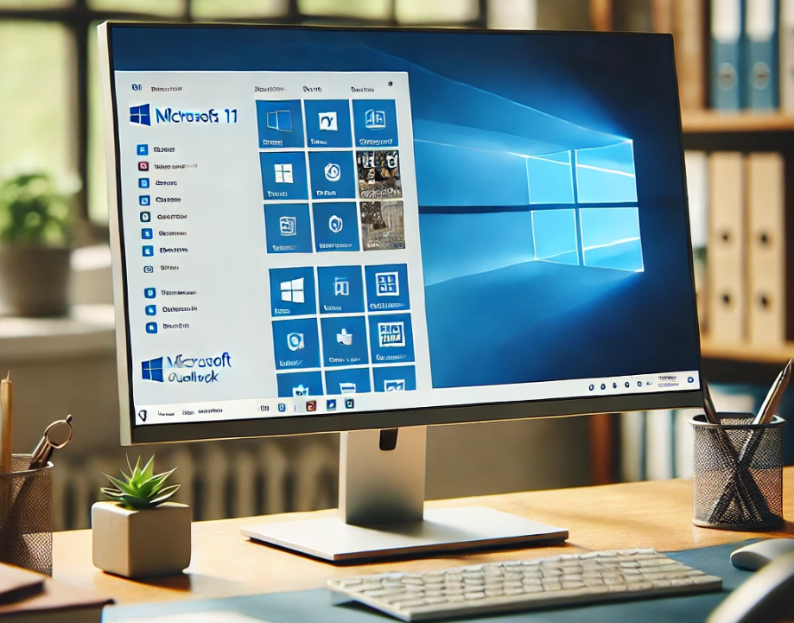
What Lies Beneath, Hidden Dangers
Your Typical Office Computer
Internet
Email
Word processing

Slide 5
What Lies Beneath, Hidden Dangers
In the background
Program Updates
Information gathering
Where you shop, bank

Slide 6
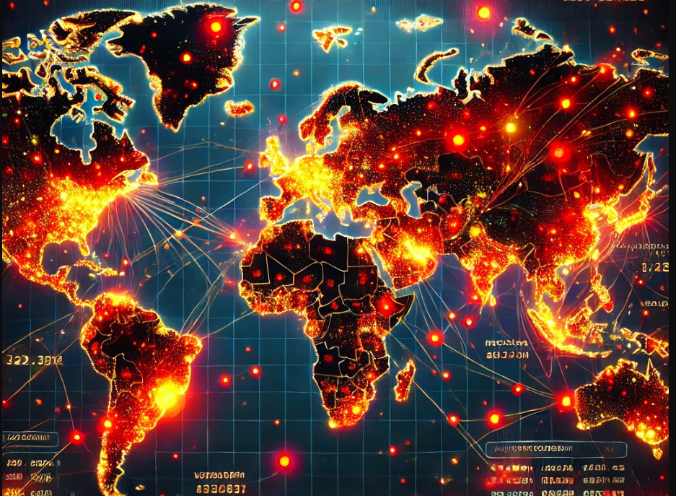
What Lies Beneath, Hidden Dangers
Not enough just to keep it running
Spyware
‘Free’ Programs
‘Shopping’ programs

Slide 7
AGENDA
Data Privacy Risks
Sub headline
Regulatory Compliance
Invoices and Billing
1
Protecting Credit Card Information. REQUIRED by your Merchant Account.
Fines, inability to take credit cards , 90 days or forever. US Secret Service Involvement
HR, Payroll, Employee Information
2
Protecting Social Security Information, Bank Account information.
State and Federal law.
Specialise in Law offices and Health Care Orgnaizations
3
Lawyers, ABA rule 1.1, formal opinion 483: Lawyers must be competent in the technology they use and inform the client if they get breached
Health Care (HIPAA): $1500 fine PER PATIENT RECORD

Slide 8
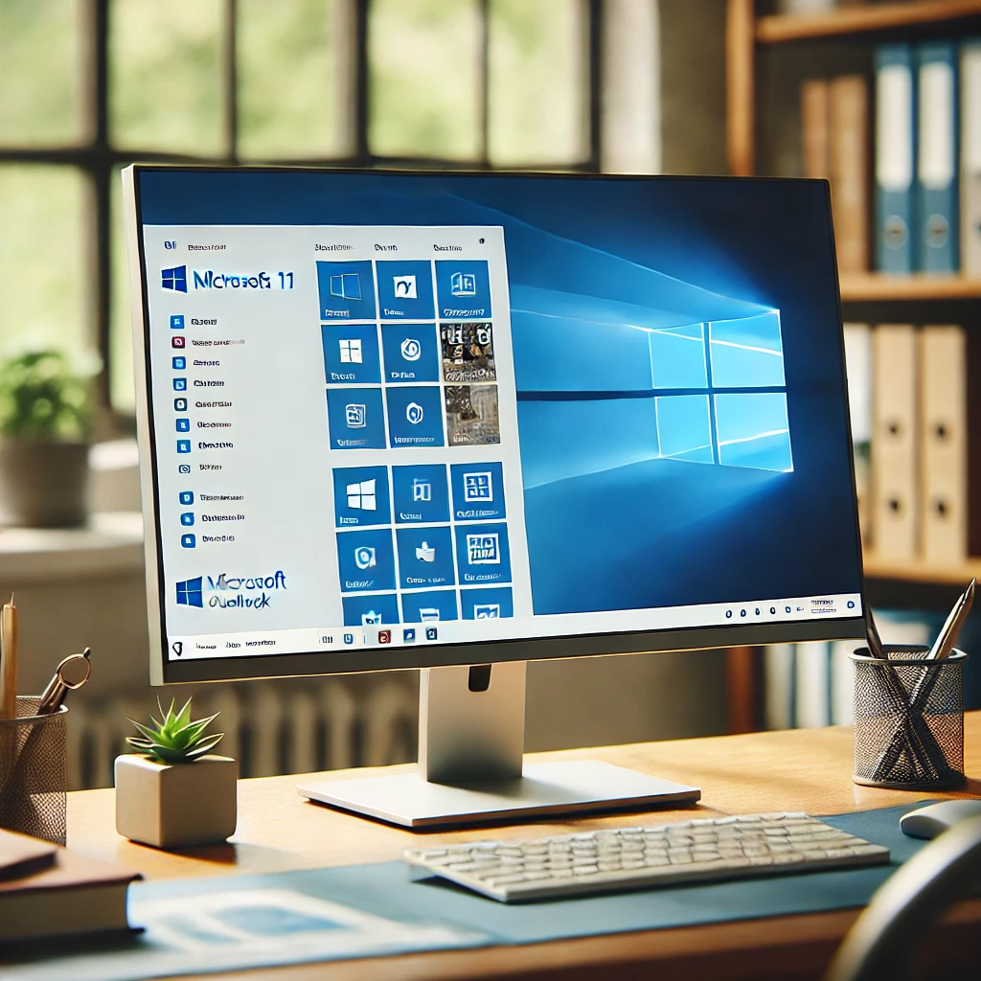
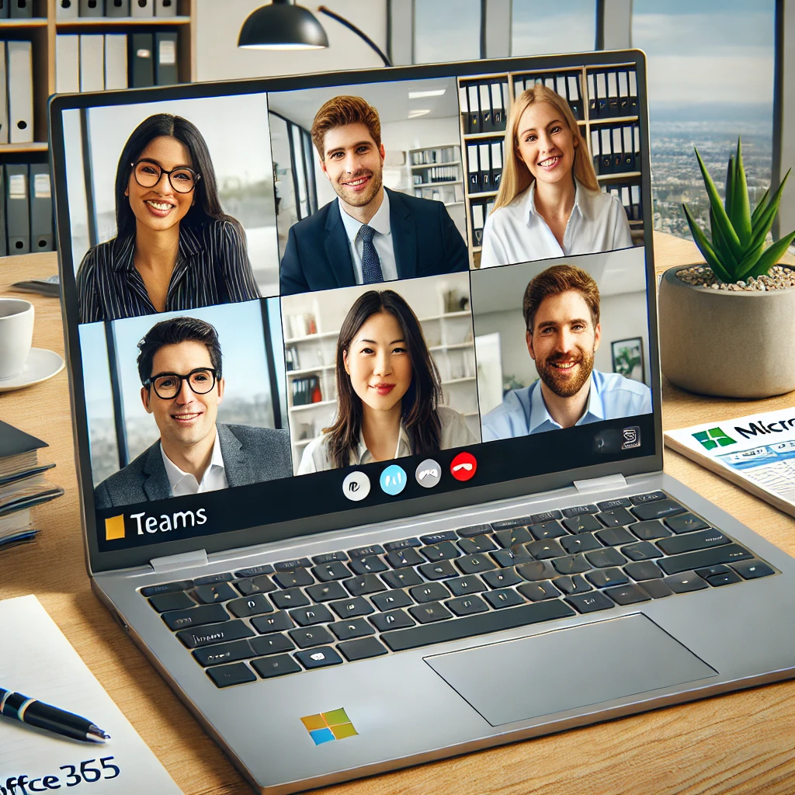
The Best Operating System
Windows 11 / Office 365
Windows 11, Productivity, Ease of use
Collaboration, Meetings
.
1
Microsoft Windows is preferred for business due to its extensive compatibility with enterprise software, enabling seamless integration across various applications essential for business operations.
2
Office 365 is preferred by businesses for its comprehensive suite of productivity tools, offering applications like Word, Excel, and Teams, which support seamless collaboration and communication.

Slide 9
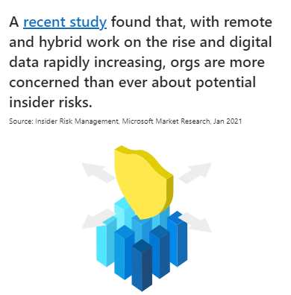
The Worst Operating System
Behind the Scene
World wide access to cloud data
Increased risks
Future ex-employee at home before leaving
1
Office 365 is frequently targeted by phishing campaigns due to its widespread use. Attackers aim to gain unauthorized access to accounts, leading to potential data leaks and unauthorized access to sensitive information.
2
Office 365 enables easy file and folder sharing, but mismanaged permissions can lead to data exposure. Sensitive information can inadvertently be shared externally if not carefully managed.

Slide 10
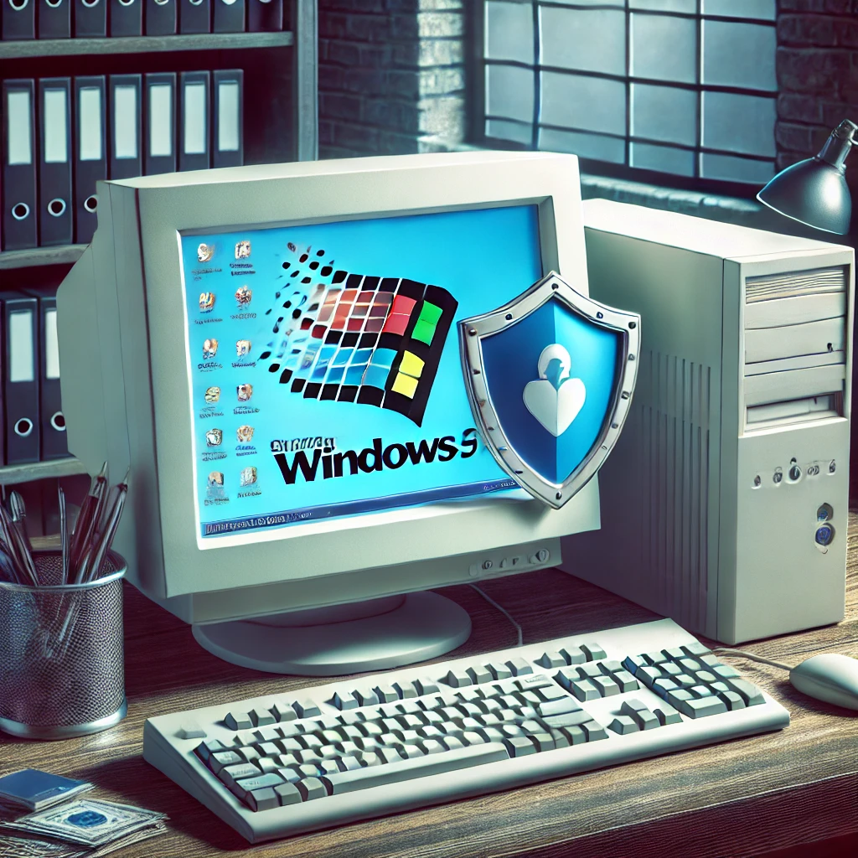
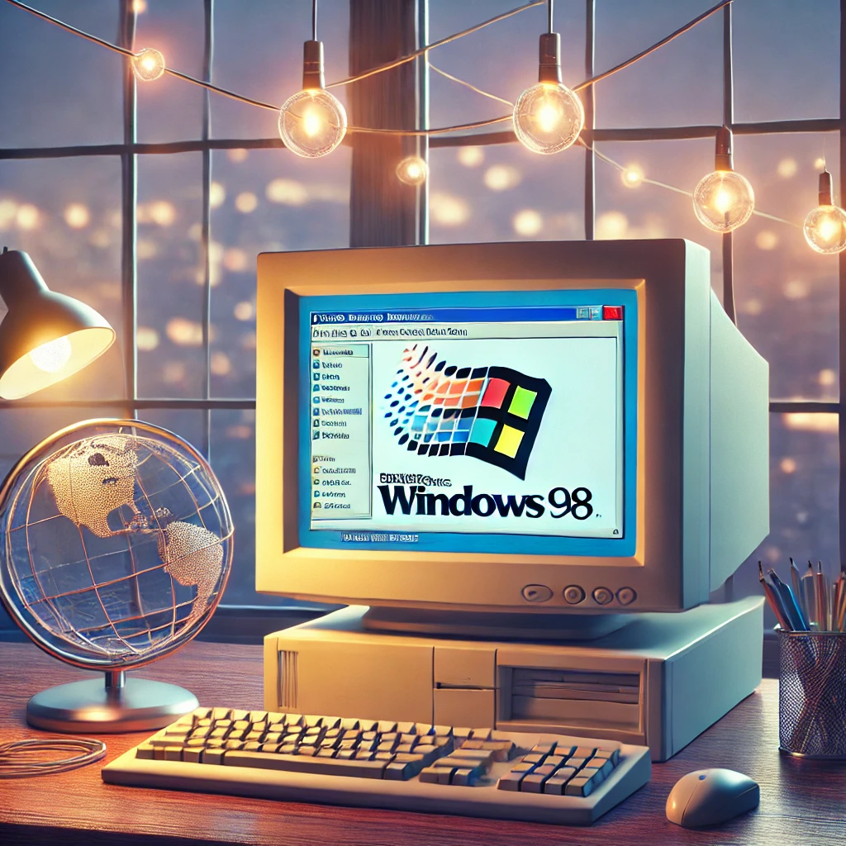
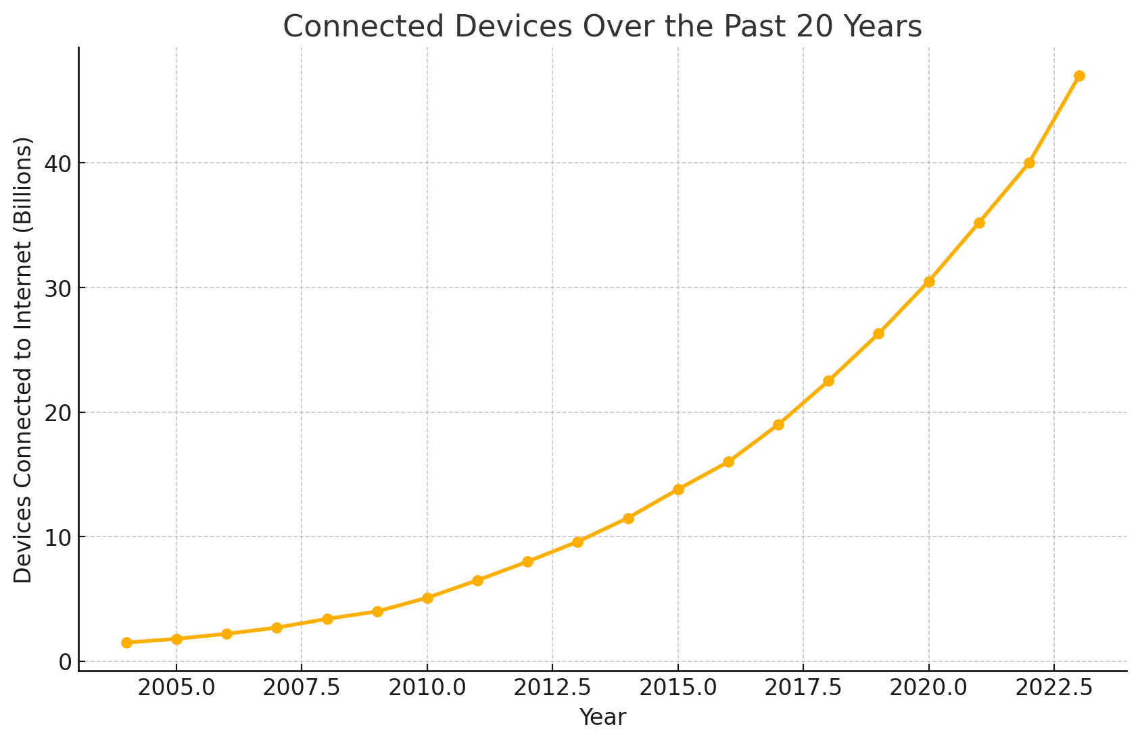
Protecting you FROM IT
Not just protecting IT
1
Windows 95, No internet, (maybe modem)
2
Windows 98, now you have the internet, AOL, prodigy, ‘
3
World Wide Web, Cloud Computing, over 40 billion. Not all of them friendly.

Slide 11
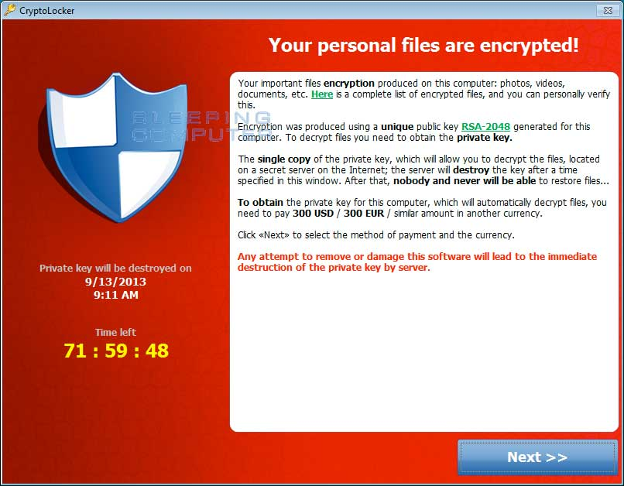
Protecting Brand Reputation
Cost of data breach
1
$100,000
Small Law office, Had backups, backups encrypted also. (ABA 483r, has to inform his clients)
2
Small and Medium Businesses (SMBs): Although lower than larger enterprises, SMBs still face significant costs, often ranging from $100,000 to $1 million depending on breach complexity and customer impact.
3
Hackerproof backups
Automatic Security Updates
Employee Training
Expert Consulting

Slide 12
Same Coin, two sides
Security
Priva(eers
Fractional CISO
Regulatory Compliance Serices
Penetration Testing
Build Security and Privacy Program
Train Full Time employees
TeamOne.Support
Managed IT Services
Workday or 24/7 support
Proactive Monitoring
Remote User Assistance
Software Installations
Backup and Disaster Recovery
Training US Service Veterans
1
Security Privateers offers cybersecurity services and IT risk management solutions, making it a valuable resource for CIOs, COOs and CFOs interested in enhancing their organization's cyber defense and compliance strategies.
2
TeamOne.Support specializes in IT support services and cybersecurity, offering solutions like technical support, backup, and recovery, specifically catering to the needs of office managers. Expertise in Microsoft Windows, Office365, and Google Workspace

Slide 13
Ideal Clients for Security Privateers
AGENDA
Sub headline
Clients
Primary Client Focus:
Companies needing advanced cybersecurity consulting, compliance audits, or assessments.
Businesses facing regulatory requirements such as HIPAA, PCI-DSS, SOC 2, or ISO/IEC 27001.
Examples of Target Clients:
Small to mid-sized companies (100-500 employees) in regulated industries:
Healthcare: Clinics, hospitals, or practices needing HIPAA assessments.
Financial Services: Firms requiring SOC 2 or PCI-DSS compliance.
Technology Providers: SaaS companies needing regulatory compliance or risk assessments.
Companies that have experienced or are concerned about cyber incidents (ransomware, phishing, data breaches).
Organizations with upcoming security certifications or vendor requirements (e.g., ISO or SOC 2 certifications).
What to Look For:
Businesses asking about cyber insurance, risk management, or compliance.
Companies with in-house IT teams that need specialized cybersecurity expertise.

Slide 14
Ideal Clients for TeamOne.Support
AGENDA
Sub headline
Clients
Primary Client Focus:
Companies that need reliable, cost-effective managed IT services to ensure business continuity and secure IT operations.
Examples of Target Clients:
Small businesses (10-150 employees) in professional services:
Law Firms: Any size. Concerned with protecting sensitive client data.
Accounting Firms: Needing secure IT and compliance with financial regulations.
Real Estate Agencies: With scattered teams and shared data needs.
Businesses in areas prone to disasters (e.g., Florida-based companies needing business continuity plans for hurricanes).
Organizations struggling with outdated IT setups, frequent tech issues, or basic security.
What to Look For:
Companies asking for help with remote work solutions, backup systems, or office tech upgrades.
Business owners who lack a dedicated IT team or are unhappy with their current IT provider.

Slide 15
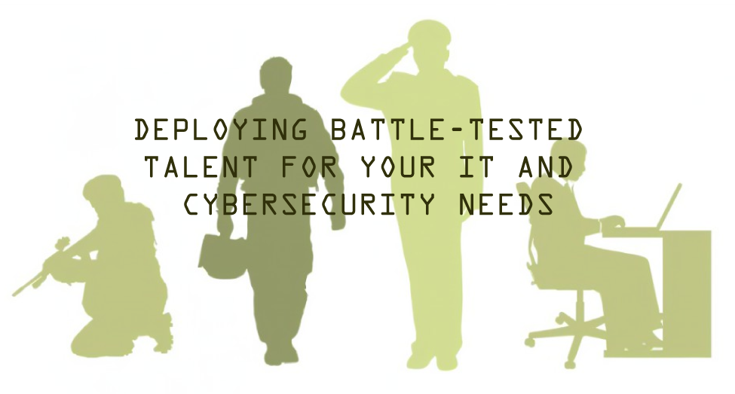
AGENDA
What we do and why
Sub headline
Full Service
Partner with greyteam.org to mentor and tech IT to US veterans.
Work week techs, 100% US based (not all vets, many are)
Optional 24/7 with international partners
Managed IT, full service

Slide 16
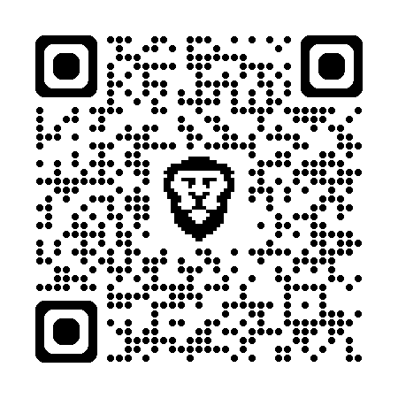
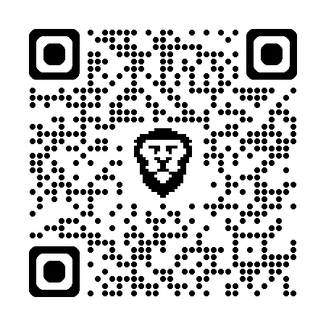
@scheidell
561-948-1305 / michael.scheidell@TeamOne.Support
http://TeamOne.Support
Download
Presentation
Download
Line Card

